Slide 1


SAP S/4HANA CDS, BTP Full Stack Training Day 8
Anubhav Oberoy

Slide 2

Day 8
OData V2 v/s V4
Fiori Elements – List Report
Metadata Extensions
Add columns to the table
Add selection fields to the filter bar
Add list report header information
Define a value help as a drop-down list
Define criticality ratings
Notes:
https://unsplash.com/photos/CPs2X8JYmS8

Slide 3
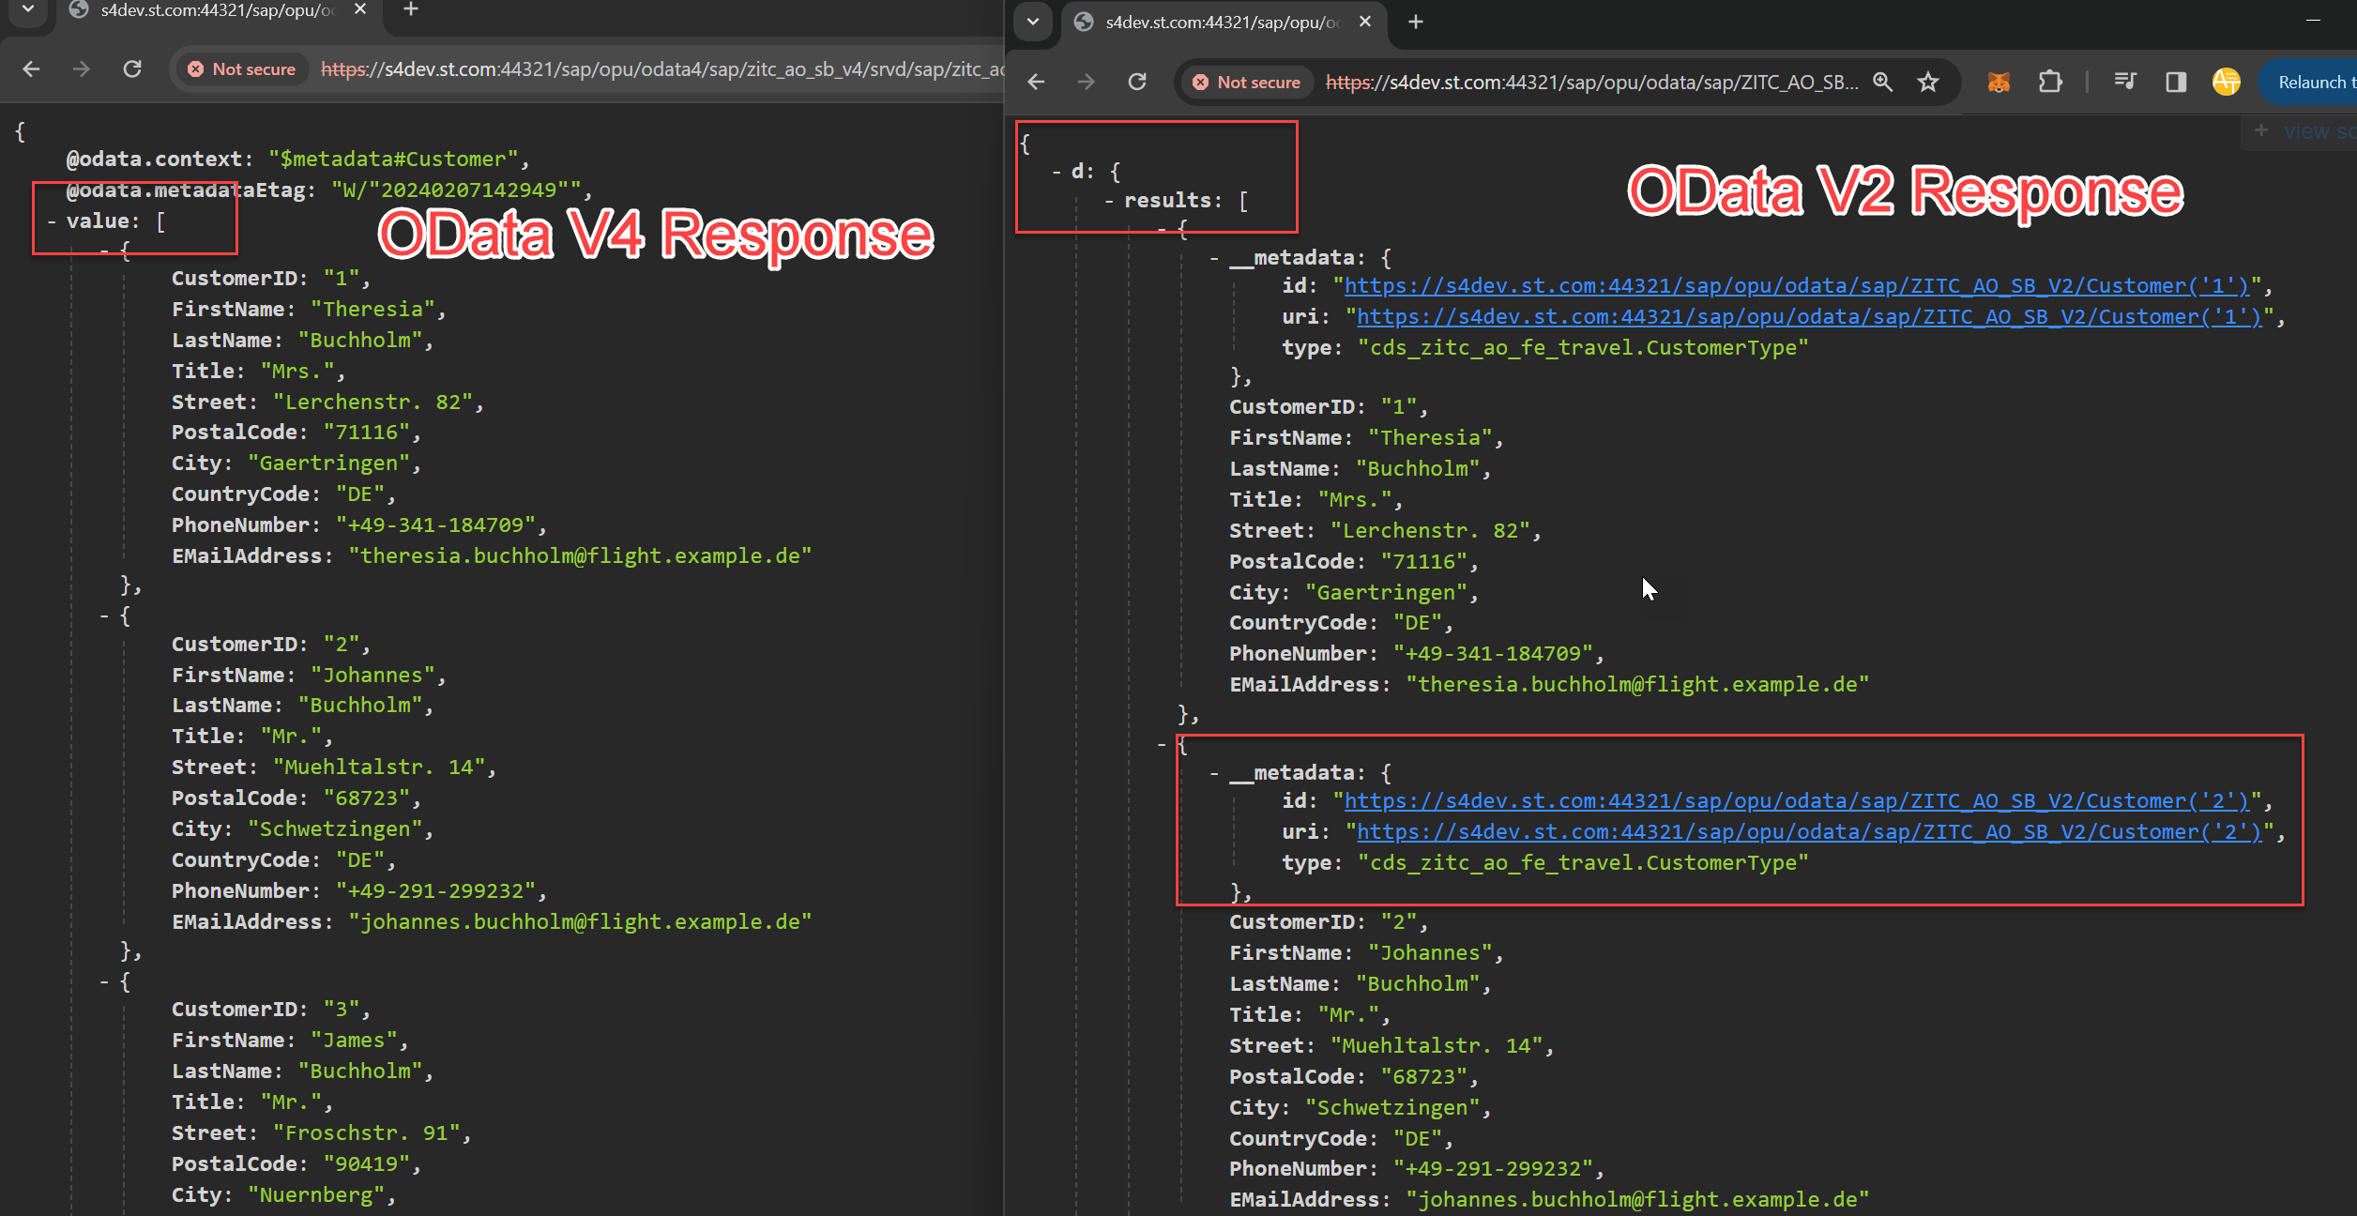

OData V2 v/s V4
content
www.anubhavtrainings.com

Slide 4


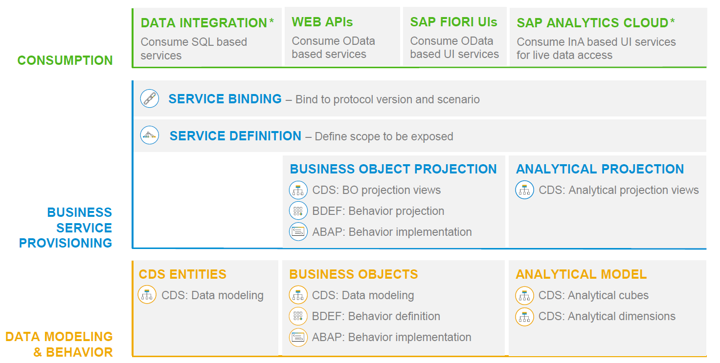
RAP – The Big picture

Slide 5

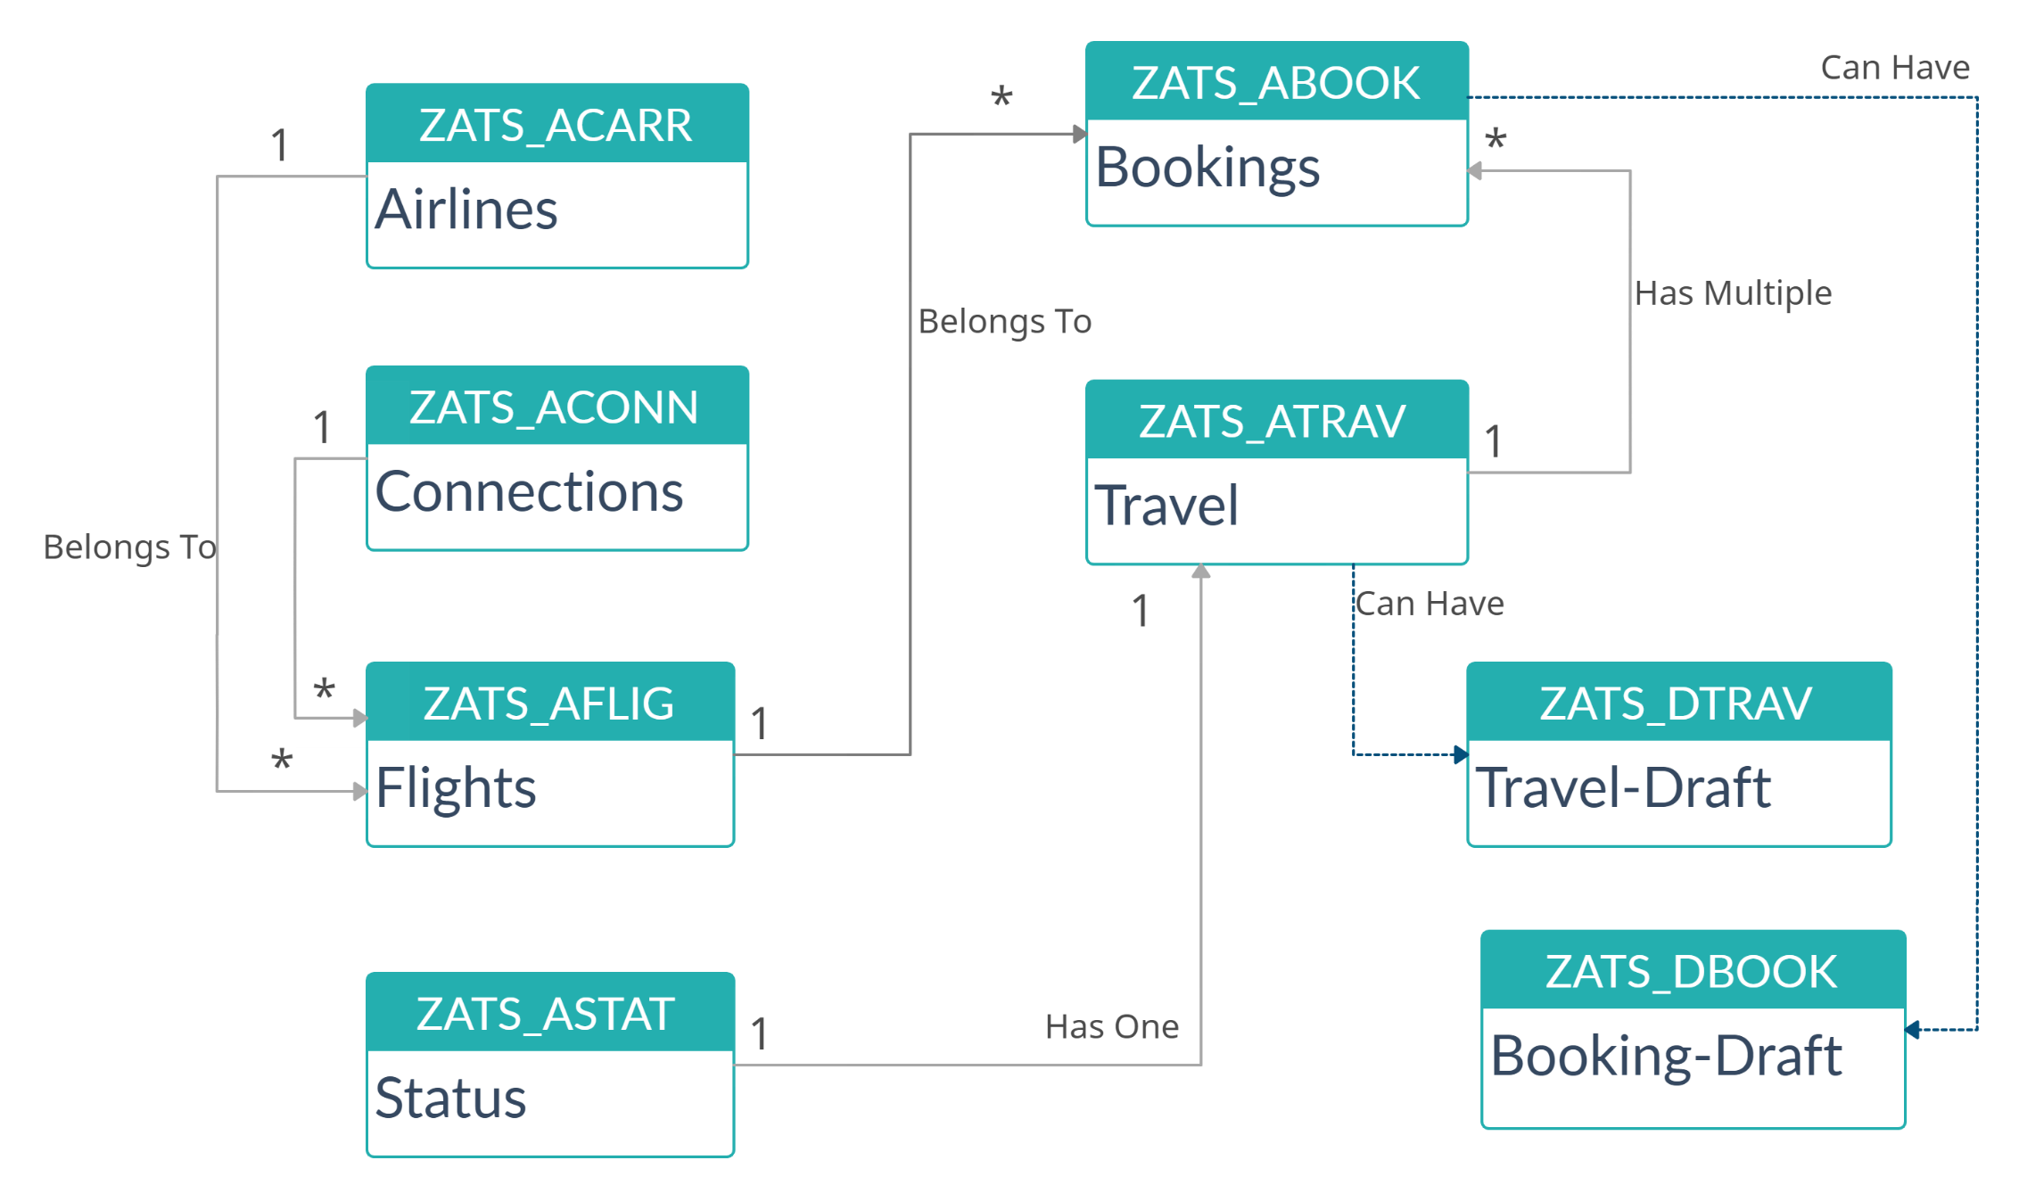
Explanation of Flight Data Model

Slide 6

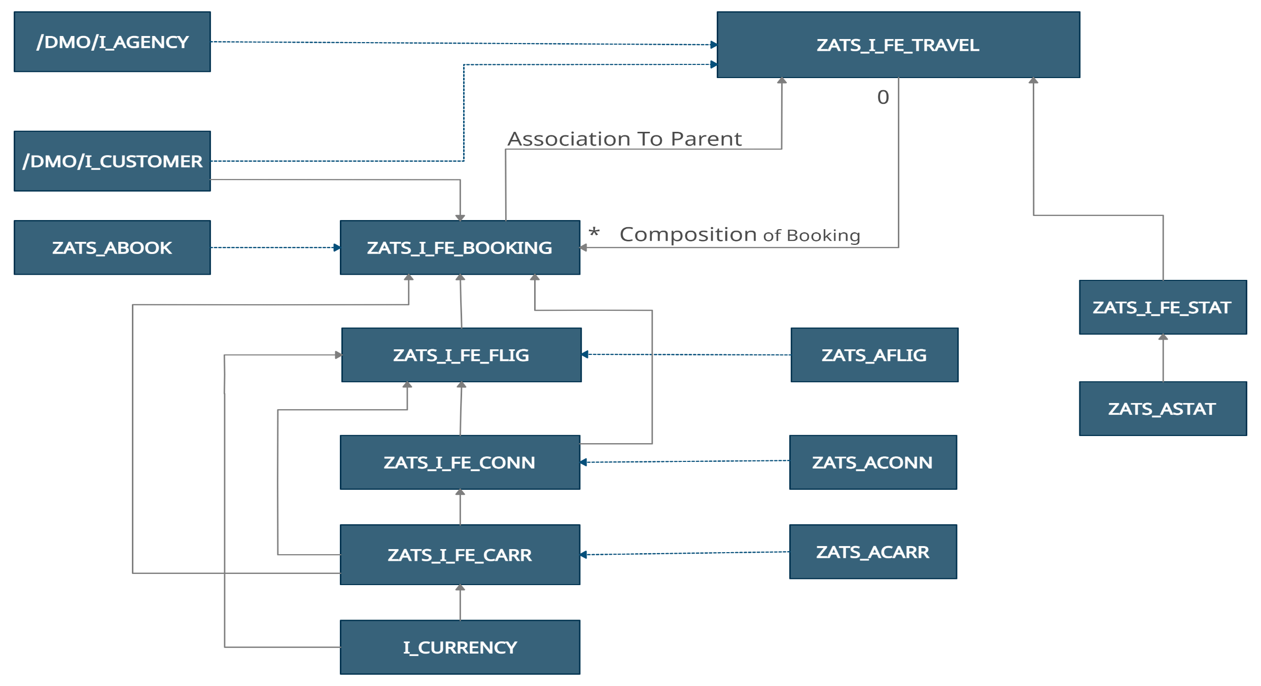
CDS Data Model
www.anubhavtrainings.com

Slide 7
Flow of Development (Unmanaged Scenario)
Fiori UI
Service Binding for UI
Service Definition
Travel – Using /demo/travel
Projection view- what we want to show to UI
1
N
I_Currency
1
N
N
Agency
Customers
I_Country

Slide 8
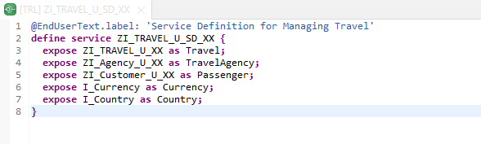
Create OData Service ( Business Service )
Create OData Service ( Business Service )
A business service definition (short form: service definition) describes which CDS entities of a data model are to be exposed so that a specific business service, for example, Sales Order handling, can be enabled. It is an ABAP Repository object that describes the consumer-specific but protocol-agnostic perspective on a data model. “ZI_TRAVEL_U_SD_XX”
CDS Entity
Service Definition
Service Binding

Slide 9
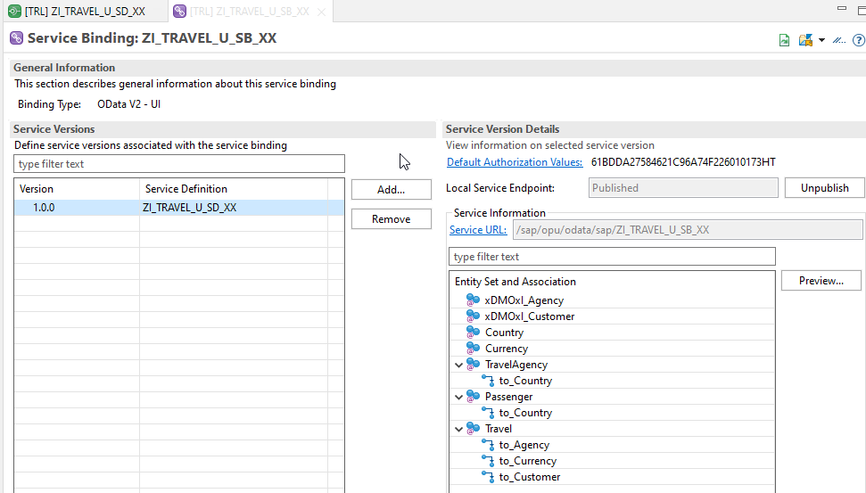
Service Binding ( Business Service )
Service Binding ( Business Service )
The business service binding (short form: service binding) is an ABAP Repository object used to bind a service definition to a client-server communication protocol such as OData. Like any other repository object, the service binding uses the proven infrastructure of the ABAP Workbench, including the transport functionality

Slide 10


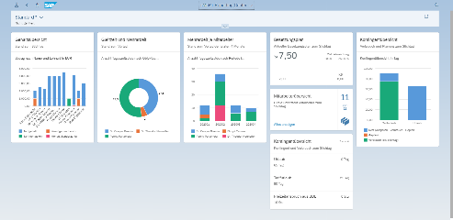





Developer Persona – Fiori Elements
Anubhav
Happy User
Rob
S/4HANA Technical consultant
ABAP Developer
Roxana
UX Designer | Fiori Developer
ABAP Dev. Tools
On
Eclipse
VS Code
BAS
OData Service
Fiori Elements Project
Annotations.xml
CDS Views
MDE
@
www.anubhavtrainings.com

Slide 11
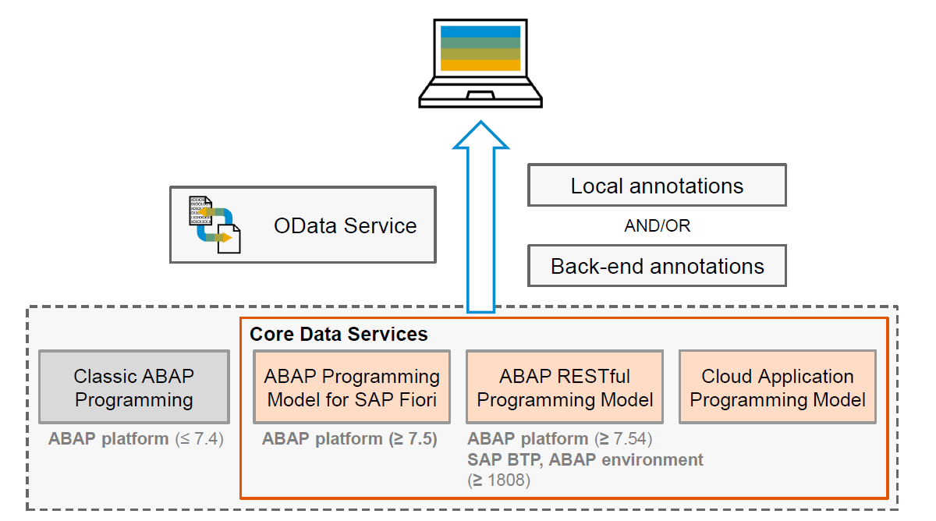
Big Picture – Architecture
www.anubhavtrainings.com

Slide 12
Annotations
Annotations are additional metadata and provide abstract definitions of data semantics. These abstract definitions are stored in vocabularies from OData and SAP. SAP Fiori elements understand the annotations and generates the UI based on them.
CDS View Annotations
XML Annotations
Annotations which are coding in ABAP system.
Require experience in ABAP on HANA and done by an ABAP or S/4HANA Consultants
CDS annotations follow the lifecycle of your OData
Service.
Due to different release cycles, some new annotations
might be available later in ABAP CDS.
More suitable if we use frameworks like RAP, & BOPF to build end to end applications
Project will be coupled with OData built on CDS hence we cannot test application if the service is down.
Easy to code and can be modularized with metadata extensions in CDS.
Use ADT tool to code the same.
Coded inside the annotations.xml file inside a Fiori Application
Require understanding of XML in general and knowledge of annotations
XML annotations follow the lifecycle of your app (local project)
With latest UI5 release, we can use new features
Suitable if we use SEGW based services, Or other frameworks which does not support the annotations.
UI projects are decoupled from the CDS and services and can be tested and transported independently.
Easy to work with the help of annotation modeler extension pack
Use BAS or VS Code to develop same.
www.anubhavtrainings.com

Slide 13
Metadata extension
When we develop CDS views, we can put many annotations inside CDS. But when we looking forward to develop a UI application, we want @UI annotations. By putting these UI annotations directly inside CDS, we are talking risk.

Slide 14
Fiori Elements - List Report Application
The list report offers powerful features for finding and acting on relevant data sets. It is often used as an entry point for navigating to the item details, which are usually shown on an object page.
List Report
Object Page
www.anubhavtrainings.com

Slide 15
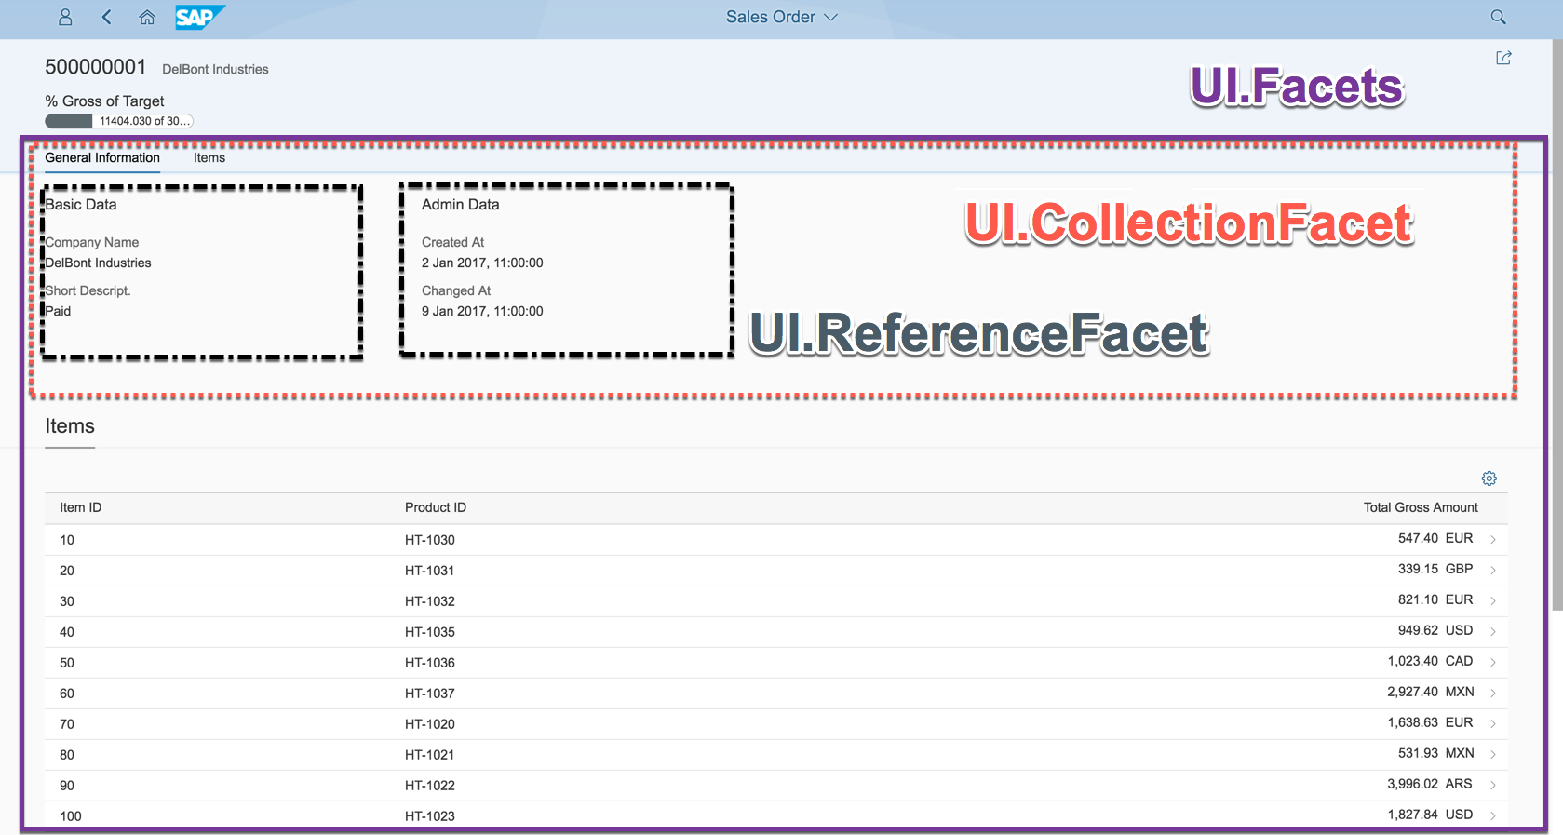
Object Page
www.anubhavtrainings.com

Slide 16
Developing Read only List Report
UI Annotations
@UI.selectionField – Bring a filter field on smart filter bar
@UI.lineItem – enable us to put a column inside the smart table, position, label
@UI.identification – used create fields in Object page
@Semantics.amount.currencyCode – mark the unit of amount field
@UI.headerInfo.typeName – Label for displaying single record
@UI.headerInfo.typeNamePlural – Table Label
@UI.facet: [{purpose : #STANDARD – This will create a section inside the object page
type: #IDENTIFICTION_REFERENCE – What type of data you want to display}]
Documentation
Documentation Link for ABAP RAP

Slide 17
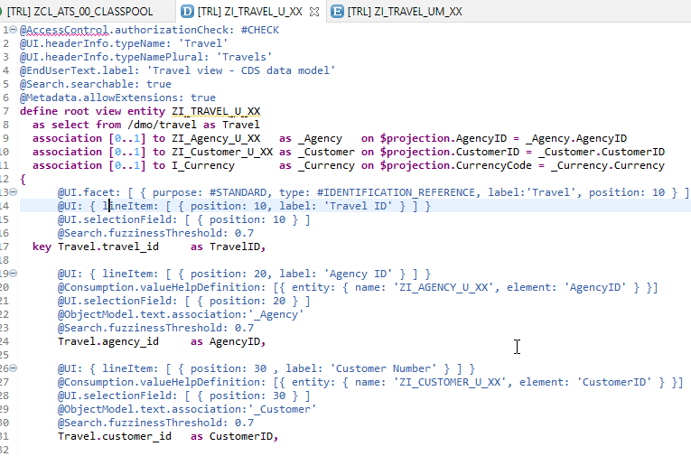
CDS Views with Annotations
Exercise
ZI_TRAVEL_U_XX ( Travel )

Slide 18
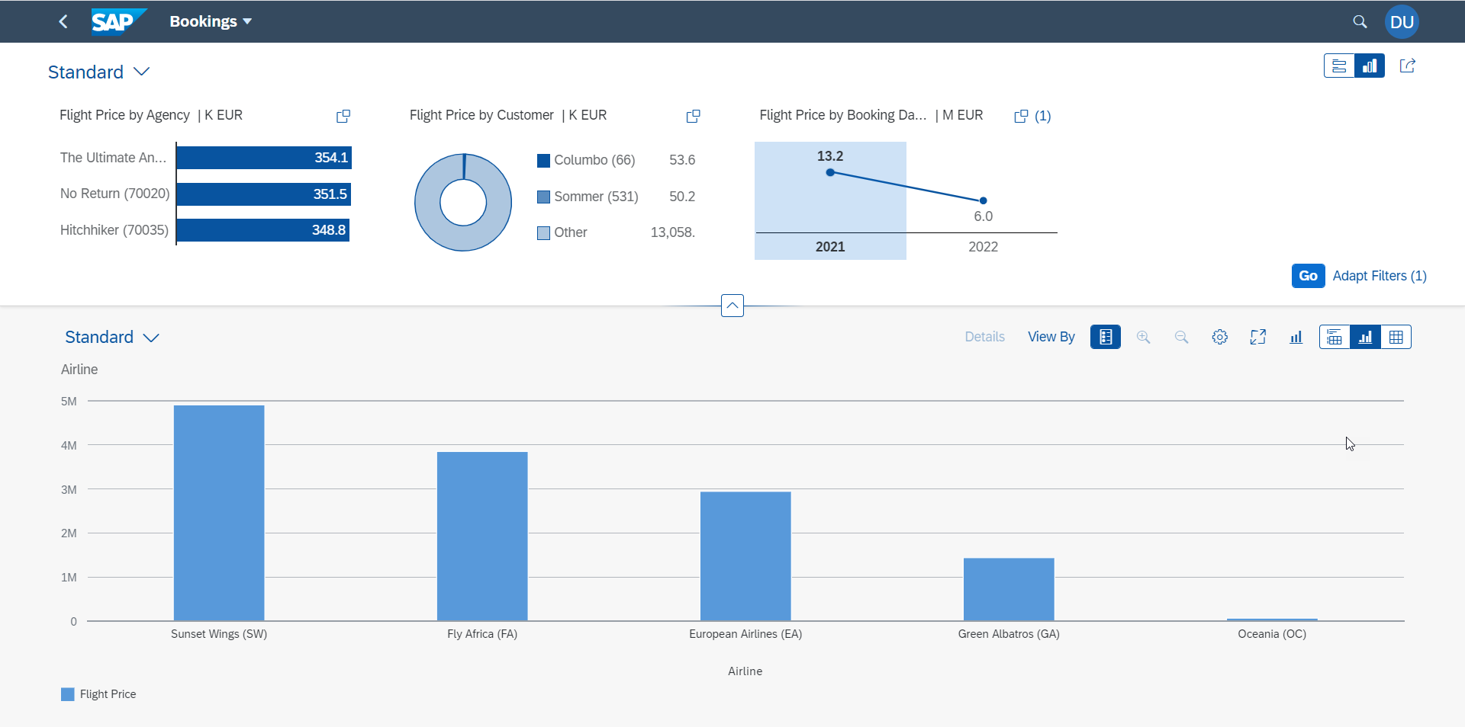
Analytic List Page
A ALP is used to display analytics as well as line item data in list. We can analyze data distribution across multiple dimensions for our measures. It also allows along with filter bar a special types of filter called visual filter.
www.anubhavtrainings.com

Slide 19
Title
content
www.anubhavtrainings.com

Slide 20

Questions?

Slide 21

Thank you
Anubhav.abap@gmail.com
contact@anubhavtrainings.com
+91 84484 54549
www.anubhavtrainings.com

